Slide 1
ANLY 530-50-2017
Nelson Corrocher

Slide 2
Introduction / Goals
Use NLP to classify movies reviews text in negative or positive polarity.
Compare the performance of different classifiers.
Report pitfalls and shortcomings in a real exercise.

Slide 3
Dataset Overview
Cornell movie review data set (as of 06/03/2017)
https://www.cs.cornell.edu/people/pabo/movie-review-data/
Composed of 27,886 reviews collected from the IMDB website.
1,000 positive and 1,000 negative reviews classified for training
Data came in HTML format
Issues with python UTF-8 encoder and decoder
Converted into unformatted text using BeautifulSoup4 python package
Besides manually classified polarity, no other annotation existed.
Relatively big dataset, caused problems for python/nltk to process it.

Slide 4
Dataset statistics
File size: 81.1Mb compressed (gave trouble to Python 32)
Total files: 27,886
Total words: 12,273,826
Average words per file: 876
Average characters per file: 4,373
4.99 characters per word (English language average is 4.79

Slide 5
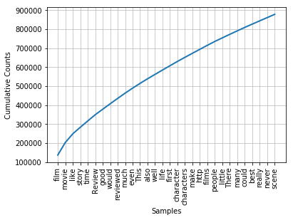
Dataset freq. dist. (len > 3)

Slide 6
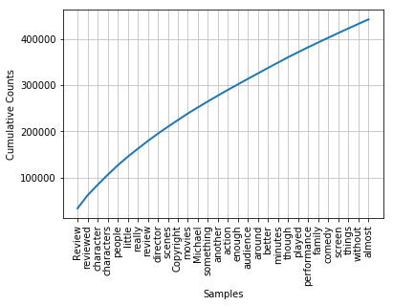
Dataset freq. dist. (len > 6)

Slide 7
Method 1/2
Use manually-classified reviews to train classifiers
Naïve Bayes, Decision Trees and Maximum Entropy
Simple procedure:
Generate corpus from unformatted text folder (my_corpus)
Generate features set using classified text (doc)
Define feature extractor to work on the classified text
Returns word list of word present/absent in positive/negative polarity
Break down the feature set into train and test set
Use sets in classifiers

Slide 8
Training/Testing sets
Both training and testing use same method.
Combines feature extractor to polarity
From the manually classified set, extracts words and polarity
To avoid unnecessary overhead, only store words that exist in the corpus
Create tuple containing (word -> is in document, polarity (pos/neg)
Break full set into training and testing
Getting the right size for each was challenging due speed vs accuracy

Slide 9
Source Code
Tokenizer and annotated data manipulation:
# Using the annotated data from polarity to construct the classifier
tokenizer = RegexpTokenizer(r'\w+')
doc = []
with codecs.open("C:\\Users\\corrocherfilhonw\\workspace\\polarity\\reviewed\\rt-polarity.pos","r","iso8859_2") as f:
for line in f:
doc.append((tokenizer.tokenize(line),'pos'))
with codecs.open("C:\\Users\\corrocherfilhonw\\workspace\\polarity\\reviewed\\rt-polarity.neg","r","iso8859_2") as f:
for line in f:
doc.append((tokenizer.tokenize(line),'neg'))
random.seed(666)
random.shuffle(doc)
RegEx Tokenizer to exclude anything that is not an alphanumeric sequence.
Manual creation of the structure used in the feature extractor

Slide 10
Source Code
Raw source (HTML) treatment:
for filename in os.listdir(htmlsource):
print(filename)
fn = filename[:filename.find('.')]
f = codecs.open(htmlsource + '\\'+ fn + '.html',"r","iso8859_2")
text = BeautifulSoup(f, "html.parser").get_text(" ")
text = text[:text.find('The review')]
s = codecs.open(corpusdir + '\\' + fn + '.txt', 'w',"utf-8")
try:
s.write(text)
except UnicodeEncodeError as e:
s.close
f.close
Code open each file, converts to text, remove the bottom of the review (common to all) and save each file as txt.
One reviewer caused a lot of trouble of using the character 0xdf in his reviews, causing exceptions in Python.

Slide 11
Results
Training Set Size (n = 10,695) | 100 (1%) |  | 500 (5%) |  | 1000 (10%) |  | 5000 (50%)
 | Speed per File (s) | Accuracy | Speed per File (s) | Accuracy | Speed per File (s) | Accuracy | Speed per File (s) | Accuracy
Naïve Bayes | 0.006 | 51.7% | 0.006 | 57.30% | 0.006 | 61.02% | 0.006 | 65.23%
Decision Trees* | 0.000 | 49.4% | 0.000 | 53.80% | 0.000 | 58.06% | 0.000# | 59.47%
Maximum Entropy | 0.004 | 50.0% | 0.003 | 50% | 0.003 | 49.92% | 0.003 | 49.60%
# Decision Trees were fast to classify but extremely slow to train. Took about 70 minutes to train the classifier using 5,000 points
No way to check down false positives and false negatives from classifiers. Thus, couldn’t calculate Precision, Recall and F-Score (no Confusion Matrix).
Max Entropy model is currently broken because of calculation that should be using integer is using double (thus, leading to Not-a-Number results). Bug was already posted in the net.
Training the model was by far the most time and processing intensive task.
Bayes provided the best results and reasonable times. Decision Trees were fast to classify but with inferior accuracy and ridiculously slow times to train. Maximum Entropy is broken so the results are not reliable.

Slide 12
Conclusions 1/2
Polarity classification is difficult:
Require big training sizes.
While still better than random, it accuracy is significantly less than what humans can do (65% vs 80%).
Yet, to reach this level, many optimizations for English language had to be used, like stopwords and punctuation exclusion, so a language-general solution would be considerably worse.
Excluding punctuation and stopwords from the text provided a accuracy improvement of about 4%.

Slide 13
Conclusions 2/2
Python or/and NLTK are not suitable for NLP processing in production:
Very slow and memory intensive - many MemoryError exceptions.
Some optimization tests couldn’t be performed due to the time each cycle took to execute.
Has unnecessary complications regarding character encoding, which hurts NLP.
NLTK is buggy and documentation is bad (Maximum Entropy classifier is broken in current version – crashes)
Each cycle was very slow, taking hours to fully run which hurt the possibility of trying many different parameters.
Removing English stopwords very slow (O(n) complexity?)

Slide 14
Potential Optimizations
Modifying the number of the word_features extracted from the FreqDist could have provided slight gains as long as the occurrences are high.
During the creation of corpus, the text could have been remove of punctuation and stopwords. This could have lead to reduced speeds in each execution cycle.
Idea not explored
Text and feature extractor using first order logic
Reduced size.
Expressive words and relations.
Would require some coding/modification of the nltk library.

Slide 15
Bibliography
Bird, Steven, Ewan Klein, and Edward Loper. Natural Language Processing With Python. Beijing: O'Reilly, 2009. Print.
"Python Module Index — NLTK 3.2.4 Documentation". Nltk.org. N.p., 2017. Web. 8 June 2017.
"Python.Org". Python.org. N.p., 2017. Web. 8 June 2017.

